Slide 1
CS288: Data Warehousing and Mining
Lecture 2
Data Warehousing and OLAP Technology for Data Mining
  Lecture slides taken/modified from:
  Jiawei Han (http://www-sal.cs.uiuc.edu/~hanj/DM_Book.html)

Slide 2
Chapter 2: Data Warehousing and OLAP Technology for Data Mining
What is a data warehouse?
A multi-dimensional data model
Data warehouse architecture
Data warehouse implementation
Further development of data cube technology
From data warehousing to data mining

Slide 3
What is Data Warehouse?
Defined in many different ways, but not rigorously.
  A decision support database that is maintained separately from the organization’s operational database
  Support information processing by providing a solid platform of consolidated, historical data for analysis.
“A data warehouse is a subject-oriented, integrated, time-variant, and nonvolatile collection of data in support of management’s decision-making process.”—W. H. Inmon
Data warehousing:
  The process of constructing and using data warehouses

Slide 4
Data Warehouse—Subject-Oriented
Provide a simple and concise view around particular subject issues by excluding data that are not useful in the decision support process.
Organized around major subjects, such as customer, product, sales.
Focusing on the modeling and analysis of data for decision makers, not on daily operations or transaction processing.

Slide 5
Data Warehouse—Integrated
Constructed by integrating multiple, heterogeneous data sources
  relational databases, flat files, on-line transaction records
Data cleaning and data integration techniques are applied.
  Ensure consistency in naming conventions, encoding structures, attribute measures, etc. among different data sources
    E.g., Hotel price: currency, tax, breakfast covered, etc.
  When data is moved to the warehouse, it is converted.

Slide 6
Data Warehouse—Time Variant
The time horizon for the data warehouse is significantly longer than that of operational systems.
  Operational database: current value data.
  Data warehouse data: provide information from a historical perspective (e.g., past 5-10 years)
Every key structure in the data warehouse
  Contains an element of time, explicitly or implicitly
  However, the key of operational data may or may not contain “time element”.

Slide 7
Data Warehouse—Non-Volatile
A physically separate store of data transformed from the operational environment.
Operational update of data does not necessarily occur in the data warehouse environment.
  Does not require transaction processing, recovery, and concurrency control mechanisms
  Often requires only two operations in data accessing:
    initial loading of data and access of data.

Slide 8
Data Warehouse vs. Heterogeneous DBMS
Traditional heterogeneous DB integration:
  Build wrappers/mediators on top of heterogeneous databases
  Query driven approach
    A query posed to a client site is translated into queries appropriate for individual heterogeneous sites; The results are integrated into a global answer set
    Involving complex information filtering
    Competition for resources at local sources
Data warehouse: update-driven, high performance
  Information from heterogeneous sources is integrated in advance and stored in warehouses for direct query and analysis

Slide 9
Data Warehouse vs. Operational DBMS
OLTP (on-line transaction processing)
  Major task of traditional relational DBMS
  Day-to-day operations: purchasing, inventory, banking, manufacturing, payroll, registration, accounting, etc.
OLAP (on-line analytical processing)
  Major task of data warehouse system
  Data analysis and decision making
Distinct features (OLTP vs. OLAP):
  User and system orientation: customer vs. market
  Data contents: current, detailed vs. historical, consolidated
  Database design: ER + application vs. star + subject
  View: current, local vs. evolutionary, integrated
  Access patterns: update vs. read-only but complex queries

Slide 10
Why Separate Data Warehouse?
High performance for both systems
  DBMS— tuned for OLTP: access methods, indexing, concurrency control, recovery
  Warehouse—tuned for OLAP: complex OLAP queries, multidimensional view, consolidation.
Different functions and different data:
  Decision support requires historical data which operational DBs do not typically maintain
  Decision Support requires consolidation (aggregation, summarization) of data from heterogeneous sources
  Different sources typically use inconsistent data representations, codes and formats which have to be reconciled

Slide 11
Chapter 2: Data Warehousing and OLAP Technology for Data Mining
What is a data warehouse?
A multi-dimensional data model
Data warehouse architecture
Data warehouse implementation
Further development of data cube technology
From data warehousing to data mining

Slide 12
A Multi-Dimensional Data Model
A data warehouse is based on a multidimensional data model which views data in the form of a data cube
A data cube allows data to be modeled and viewed in multiple dimensions
  Dimension tables, such as item (item_name, brand, type), or time(day, week, month, quarter, year)
  Fact table contains measures (such as dollars_sold) and keys to each of the related dimension tables
In data warehousing literature, an n-D base cube is called a base cuboid. The top most 0-D cuboid, which holds the highest-level of summarization, is called the apex cuboid. The lattice of cuboids forms a data cube.

Slide 13

A Sample Data Cube
Time
Total annual sales
of TV in U.S.A.
1Qtr
2Qtr
3Qtr
4Qtr
sum
TV
Item
PC
U.S.A
VCR
sum
Location
Canada
Mexico
sum
All, All, All

Slide 14
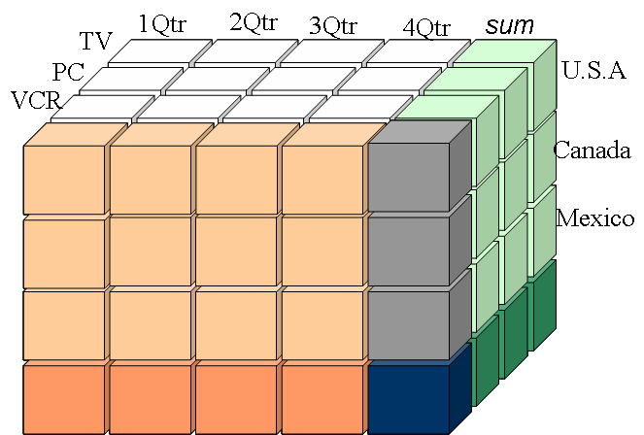
4-D Data Cube
Supplier 1
Supplier 2
Supplier 3

Slide 15
Cube: A Lattice of Cuboids
all
0-D(apex) cuboid
time
item
location
supplier
1-D cuboids
time,item
time,location
item,location
location,supplier
2-D cuboids
time,supplier
item,supplier
time,item,location
time,location,supplier
3-D cuboids
time,item,supplier
item,location,supplier
4-D(base) cuboid
time, item, location, supplier

Slide 16
Conceptual Modeling of Data Warehouses
Modeling data warehouses: dimensions & measures
  Star schema: A fact table in the middle connected to a set of dimension tables
  Snowflake schema: A refinement of star schema where some dimensional hierarchy is normalized into a set of smaller dimension tables, forming a shape similar to snowflake
  Fact constellations: Multiple fact tables share dimension tables, viewed as a collection of stars, therefore called galaxy schema or fact constellation

Slide 17
Example of Star Schema
time
time_key
day
day_of_the_week
month
quarter
year
item
item_key
item_name
brand
type
supplier_type
Sales Fact Table
time_key
item_key
branch_key
branch
location
location_key
branch_key
branch_name
branch_type
location_key
street
city
province_or_street
country
units_sold
dollars_sold
avg_sales
Measures

Slide 18
Example of Snowflake Schema
time
item
time_key
day
day_of_the_week
month
quarter
year
item_key
item_name
brand
type
supplier_key
supplier
Sales Fact Table
supplier_key
supplier_type
time_key
item_key
branch_key
branch
location
location_key
location_key
street
city_key
branch_key
branch_name
branch_type
units_sold
city
dollars_sold
city_key
city
province
country
avg_sales
Measures

Slide 19
Example of Fact Constellation
time
time_key
day
day_of_the_week
month
quarter
year
Shipping Fact Table
item
Sales Fact Table
item_key
item_name
brand
type
supplier_type
time_key
time_key
item_key
shipper_key
item_key
branch_key
from_location
branch
location_key
location
to_location
branch_key
branch_name
branch_type
units_sold
location_key
street
city
province_or_street
country
dollars_cost
dollars_sold
units_shipped
avg_sales
shipper
Measures
shipper_key
shipper_name
location_key
shipper_type

Slide 20
A Data Mining Query Language, DMQL: Language Primitives
Cube Definition (Fact Table)
  define cube <cube_name> [<dimension_list>]: <measure_list>
Dimension Definition (Dimension Table)
  define dimension <dimension_name> as (<attribute_or_subdimension_list>)
Special Case (Shared Dimension Tables)
  First time as “cube definition”
  define dimension <dimension_name> as <dimension_name_first_time> in cube <cube_name_first_time>

Slide 21
Defining a Star Schema in DMQL
define cube sales_star [time, item, branch, location]:
    dollars_sold = sum(sales_in_dollars), avg_sales = avg(sales_in_dollars), units_sold = count(*)
define dimension time as (time_key, day, day_of_week, month, quarter, year)
define dimension item as (item_key, item_name, brand, type, supplier_type)
define dimension branch as (branch_key, branch_name, branch_type)
define dimension location as (location_key, street, city, province_or_state, country)

Slide 22
Defining a Snowflake Schema in DMQL
define cube sales_snowflake [time, item, branch, location]:
    dollars_sold = sum(sales_in_dollars), avg_sales = avg(sales_in_dollars), units_sold = count(*)
define dimension time as (time_key, day, day_of_week, month, quarter, year)
define dimension item as (item_key, item_name, brand, type, supplier(supplier_key, supplier_type))
define dimension branch as (branch_key, branch_name, branch_type)
define dimension location as (location_key, street, city(city_key, province_or_state, country))

Slide 23
Defining a Fact Constellation in DMQL
define cube sales [time, item, branch, location]:
    dollars_sold = sum(sales_in_dollars), avg_sales = avg(sales_in_dollars), units_sold = count(*)
define dimension time as (time_key, day, day_of_week, month, quarter, year)
define dimension item as (item_key, item_name, brand, type, supplier_type)
define dimension branch as (branch_key, branch_name, branch_type)
define dimension location as (location_key, street, city, province_or_state, country)
define cube shipping [time, item, shipper, from_location, to_location]:
    dollar_cost = sum(cost_in_dollars), unit_shipped = count(*)
define dimension time as time in cube sales
define dimension item as item in cube sales
define dimension shipper as (shipper_key, shipper_name, location as location in cube sales, shipper_type)
define dimension from_location as location in cube sales
define dimension to_location as location in cube sales

Slide 24
Measures: Three Categories
Measure: a function evaluated on aggregated data corresponding to given dimension-value pairs.
Measures can be:
distributive: if the measure can be calculated in a distributive manner.
    E.g., count(), sum(), min(), max().
algebraic: if it can be computed from arguments obtained by applying distributive aggregate functions.
    E.g., avg()=sum()/count(), min_N(), standard_deviation().
holistic: if it is not algebraic.
    E.g., median(), mode(), rank().

Slide 25
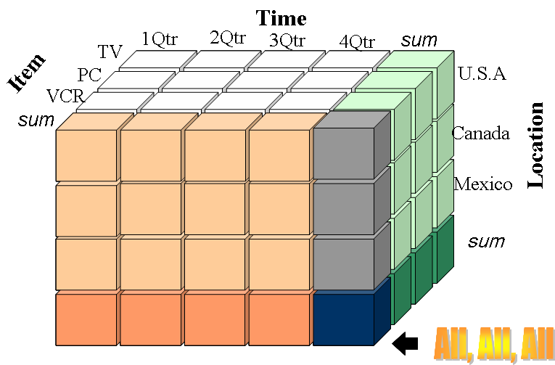
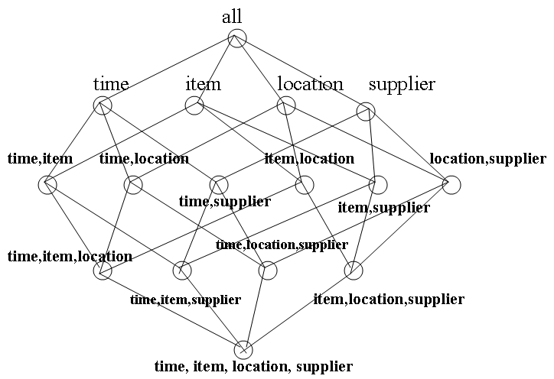
Measures: Three Categories
Distributive and algebraic measures are ideal for data cubes.
Calculated measures at lower levels can be used directly at higher levels.
Holistic measures can be difficult to calculate efficiently.
Holistic measures could often be efficiently approximated.

Slide 26

Browsing a Data Cube
Visualization
OLAP capabilities
Interactive manipulation

Slide 27
A Concept Hierarchy
Concept hierarchies allow data to be handled at varying levels of abstraction
Region
Dimensions: Product, Location, Time
Hierarchical summarization paths
Industry Region Year
Category Country Quarter
Product City Month Week
Office Day
Product
Month

Slide 28
Typical OLAP Operations (Fig 2.10)
Roll up (drill-up): summarize data
  by climbing up concept hierarchy or by dimension reduction
Drill down (roll down): reverse of roll-up
  from higher level summary to lower level summary or detailed data, or introducing new dimensions
Slice and dice:
  project and select
Pivot (rotate):
  reorient the cube, visualization, 3D to series of 2D planes.
Other operations
  drill across: involving (across) more than one fact table
  drill through: through the bottom level of the cube to its back-end relational tables (using SQL)

Slide 29
Querying Using a Star-Net Model
Customer Orders
Shipping Method
Customer
CONTRACTS
AIR-EXPRESS
Each circle is called a footprint
ORDER
TRUCK
PRODUCT LINE
Time
Product
ANNUALY
QTRLY
DAILY
PRODUCT ITEM
PRODUCT GROUP
CITY
SALES PERSON
COUNTRY
DISTRICT
REGION
DIVISION
Location
Promotion
Organization

Slide 30
Chapter 2: Data Warehousing and OLAP Technology for Data Mining
What is a data warehouse?
A multi-dimensional data model
Data warehouse architecture
Data warehouse implementation
Further development of data cube technology
From data warehousing to data mining

Slide 31
Data Warehouse Design Process
Top-down, bottom-up approaches or a combination of both
  Top-down: Starts with overall design and planning (mature)
  Bottom-up: Starts with experiments and prototypes (rapid)
From software engineering point of view
  Waterfall: structured and systematic analysis at each step before proceeding to the next
  Spiral: rapid generation of increasingly functional systems, quick modifications, timely adaptation of new designs and technologies
Typical data warehouse design process
  Choose a business process to model, e.g., orders, invoices, etc.
  Choose the grain (atomic level of data) of the business process
  Choose the dimensions that will apply to each fact table record
  Choose the measure that will populate each fact table record

Slide 32
Multi-Tiered Architecture
Monitor
&
Integrator
OLAP Server
other
sources
Metadata
Analysis
Query
Reports
Data mining
Operational
DBs
Extract
Transform
Load
Refresh
Data
Warehouse
Serve
Data Marts
Data Sources
Data Storage
OLAP Engine
Front-End Tools

Slide 33
Three Data Warehouse Models
Enterprise warehouse
  collects all of the information about subjects spanning the entire organization
Data Mart
  a subset of corporate-wide data that is of value to a specific groups of users. Its scope is confined to specific, selected groups, such as marketing data mart
    Independent vs. dependent (directly from warehouse) data mart
Virtual warehouse
  A set of views over operational databases
  Only some of the possible summary views may be materialized

Slide 34
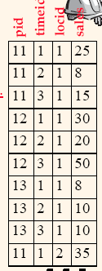
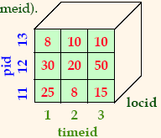
OLAP Server Architectures
Relational OLAP (ROLAP)
  Use relational or extended-relational DBMS to store and manage warehouse data
  Include optimization of DBMS backend and additional tools and services
  greater scalability
Multidimensional OLAP (MOLAP)
  Array-based multidimensional storage engine (sparse matrix techniques)
  fast indexing to pre-computed summarized data
Hybrid OLAP (HOLAP)
  User flexibility (low level: relational, high-level: array)
Specialized SQL servers
  specialized support for SQL queries over star/snowflake schemas

Slide 35
Chapter 2: Data Warehousing and OLAP Technology for Data Mining
What is a data warehouse?
A multi-dimensional data model
Data warehouse architecture
Data warehouse implementation
Further development of data cube technology
From data warehousing to data mining

Slide 36
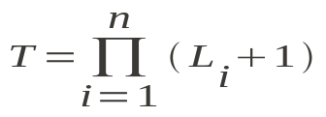
Efficient Data Cube Computation
Data cube can be viewed as a lattice of cuboids
  The bottom-most cuboid is the base cuboid
  The top-most cuboid (apex) contains only one cell
  How many cuboids in an n-dimensional cube with L levels?
Materialization of data cube
  Materialize every (cuboid) (full materialization), none (no materialization), or some (partial materialization)
  Selection of which cuboids to materialize
    Based on size, sharing, access frequency, etc.

Slide 37
Cube Operation
Cube definition and computation in DMQL
    define cube sales[item, city, year]: sum(sales_in_dollars)
    compute cube sales
Transform it into a SQL-like language (with a new operator cube by, introduced by Gray et al.’96)
    SELECT item, city, year, SUM (amount)
    FROM SALES
    CUBE BY item, city, year
Need compute the following Group-Bys
    (date, product, customer),
    (date,product),(date, customer), (product, customer),
    (date), (product), (customer)
    ()
()
(city)
(item)
(year)
(city, item)
(city, year)
(item, year)
    SELECT item, city, year, SUM (amount)
    FROM SALES
    GROUP BY item, year
(city, item, year)

Slide 38
Cube Computation: ROLAP vs. MOLAP
ROLAP-based cubing algorithms
  Key-based addressing
  Sorting, hashing, and grouping operations are applied to the dimension attributes to reorder and cluster related tuples
  Aggregates may be computed from previously computed aggregates, rather than from the base fact table
MOLAP-based cubing algorithms
  Direct array addressing
  Partition the array into chunks that fit the memory
  Compute aggregates by visiting cube chunks
  Possible to exploit ordering of chunks for faster calculation

Slide 39
Multiway Array Aggregation for MOLAP
Partition arrays into chunks (a small subcube which fits in memory).
Compressed sparse array addressing: (chunk_id, offset)
Compute aggregates in “multiway” by visiting cube cells in the order which minimizes the # of times to visit each cell, and reduces memory access and storage cost.
C
c3
61
62
63
64
c2
45
46
47
48
c1
29
30
31
32
What is the best traversing order to do multi-way aggregation?
c 0
B
60
b3
13
14
15
16
44
9
28
56
b2
B
40
24
52
b1
5
36
20
b0
1
2
3
4
a0
a1
a2
a3
A

Slide 40
Multiway Array Aggregation for MOLAP
C
c3
61
62
63
64
c2
45
46
47
48
c1
29
30
31
32
c 0
B
60
b3
13
14
15
16
44
B
9
28
56
b2
40
5
24
52
b1
36
20
b0
1
2
3
4
After scan {1,2,3,4}:
b₀c₀ chunk is computed
a₀c₀ and a₀b₀ are not computed
a0
a1
a2
a3
A

Slide 41
Multiway Array Aggregation for MOLAP
We need to keep a single b-c chunk in memory
We need to keep 4 a-c chunks in memory
C
c3
61
62
63
64
After scan 1-13:
a₀c₀ and b₀c₀ chunks are computed
a₀b₀ is not computed (we will need to scan 1-49)
c2
45
46
47
48
c1
29
30
31
32
c 0
B
60
b3
13
14
15
16
44
B
9
28
56
b2
40
5
24
52
b1
36
20
b0
1
2
3
4
a0
a1
a2
a3
A
We need to keep 16 a-b chunks in memory

Slide 42
Multiway Array Aggregation for MOLAP
Method: the planes should be sorted and computed according to their size in ascending order.
  The proposed scan is optimal if |C|>|B|>|A|
  See the details of Example 2.12 (pp. 75-78)
MOLAP cube computation is faster than ROLAP
Limitation of MOLAP: computing well only for a small number of dimensions
If there are a large number of dimensions use the iceberg cube computation: process only “dense” chunks

Slide 43

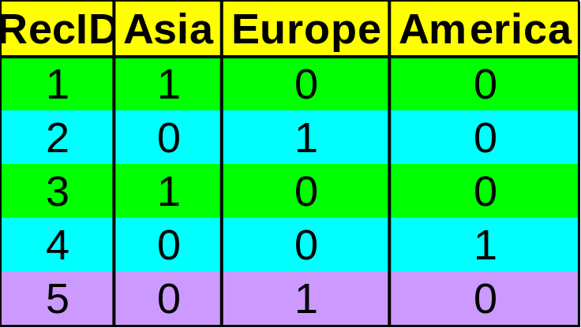

Indexing OLAP Data: Bitmap Index
Suitable for low cardinality domains
Index on a particular column
Each value in the column has a bit vector: bit-op is fast
The length of the bit vector: # of records in the base table
The i-th bit is set if the i-th row of the base table has the value for the indexed column
Base table
Index on Region
Index on Type

Slide 44

Indexing OLAP Data: Join Indices
Join index materializes relational join and speeds up relational join — a rather costly operation
In data warehouses, join index relates the values of the dimensions of a start schema to rows in the fact table.
  E.g. fact table: Sales and two dimensions location and item
    A join index on location is a list of pairs <loc_name,T_id> sorted by location
    A join index on location-and-item is a list of triples <loc_name,item_name, T_id> sorted by location and item names
Search of a join index can still be slow
Bitmapped join index allows speed-up by using bit vectors instead of dimension attribute names

Slide 45
Online Aggregation
Consider an aggregate query:
    “finding the average sales by state“
Can we provide the user with some information before the exact average is computed for all states?
  Solution: show the current “running average” for each state as the computation proceeds.
  Even better, if we use statistical techniques and sample tuples to aggregate instead of simply scanning the aggregated table, we can provide bounds such as “the average for Wisconsin is 2000±102 with 95% probability.

Slide 46
Efficient Processing of OLAP Queries
Determine which operations should be performed on the available cuboids:
  transform drill, roll, etc. into corresponding SQL and/or OLAP operations, e.g, dice = selection + projection
Determine to which materialized cuboid(s) the relevant operations should be applied.
Exploring indexing structures and compressed vs. dense array structures in MOLAP (trade-off between indexing and storage performance)

Slide 47
Metadata Repository
Meta data is the data defining warehouse objects. It has the following kinds
  Description of the structure of the warehouse
    schema, view, dimensions, hierarchies, derived data definitions, data mart locations and contents
  Operational meta-data
    data lineage (history of migrated data and transformation path), currency of data (active, archived, or purged), monitoring information (warehouse usage statistics, error reports, audit trails)
  The algorithms used for summarization
  The mapping from operational environment to the data warehouse
  Data related to system performance
    warehouse schema, view and derived data definitions
  Business data
    business terms and definitions, ownership of data, charging policies

Slide 48
Data Warehouse Back-End Tools and Utilities
Data extraction:
  get data from multiple, heterogeneous, and external sources
Data cleaning:
  detect errors in the data and rectify them when possible
Data transformation:
  convert data from legacy or host format to warehouse format
Load:
  sort, summarize, consolidate, compute views, check integrity, and build indices and partitions
Refresh
  propagate the updates from the data sources to the warehouse

Slide 49
Chapter 2: Data Warehousing and OLAP Technology for Data Mining
What is a data warehouse?
A multi-dimensional data model
Data warehouse architecture
Data warehouse implementation
Further development of data cube technology
From data warehousing to data mining

Slide 50
Discovery-Driven Exploration of Data Cubes
Hypothesis-driven: exploration by user, huge search space
Discovery-driven (Sarawagi et al.’98)
  pre-compute measures indicating exceptions, guide user in the data analysis, at all levels of aggregation
  Exception: significantly different from the value anticipated, based on a statistical model
  Visual cues such as background color are used to reflect the degree of exception of each cell
  Computation of exception indicator can be overlapped with cube construction

Slide 51



Examples: Discovery-Driven Data Cubes

Slide 52
Chapter 2: Data Warehousing and OLAP Technology for Data Mining
What is a data warehouse?
A multi-dimensional data model
Data warehouse architecture
Data warehouse implementation
Further development of data cube technology
From data warehousing to data mining

Slide 53
Data Warehouse Usage
Three kinds of data warehouse applications
  Information processing
    supports querying, basic statistical analysis, and reporting using crosstabs, tables, charts and graphs
  Analytical processing
    multidimensional analysis of data warehouse data
    supports basic OLAP operations, slice-dice, drilling, pivoting
  Data mining
    knowledge discovery from hidden patterns
    supports associations, constructing analytical models, performing classification and prediction, and presenting the mining results using visualization tools.
Differences among the three tasks

Slide 54
From On-Line Analytical Processing to On Line Analytical Mining (OLAM)
Why online analytical mining?
  High quality of data in data warehouses
    DW contains integrated, consistent, cleaned data
  Available information processing structure surrounding data warehouses
    ODBC, OLEDB, Web accessing, service facilities, reporting and OLAP tools
  OLAP-based exploratory data analysis
    mining with drilling, dicing, pivoting, etc.
  On-line selection of data mining functions
    integration and swapping of multiple mining functions, algorithms, and tasks.
Architecture of OLAM

Slide 55
Summary
Data warehouse
  A subject-oriented, integrated, time-variant, and nonvolatile collection of data in support of management’s decision-making process
A multi-dimensional model of a data warehouse
  Star schema, snowflake schema, fact constellations
  A data cube consists of dimensions & measures
OLAP operations: drilling, rolling, slicing, dicing and pivoting
OLAP servers: ROLAP, MOLAP, HOLAP
Efficient computation of data cubes
  Partial vs. full vs. no materialization
  Multiway array aggregation
  Bitmap index and join index implementations
Further development of data cube technology
  Discovery-drive and multi-feature cubes
  From OLAP to OLAM (on-line analytical mining)

